Slide 1
BASICS OF SYMMETRIC CRYPTOGRAPHY Vitaly Shmatikov

Slide 2
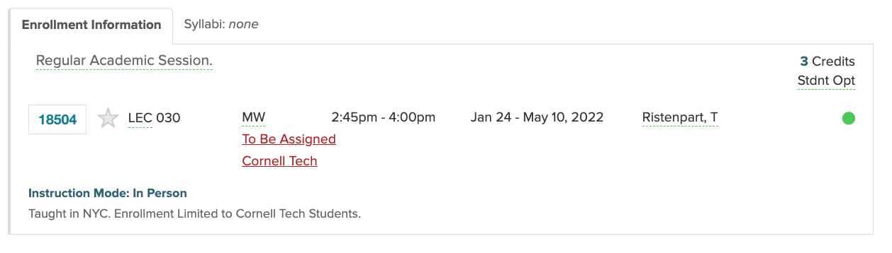
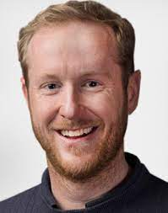
CS 5830 Cryptography (Spring 2022)

Slide 3


Online Shopping with HTTPS (HTTP over TLS)
https://amazon.com
Step 1:
Key exchange protocol to share secret K
K
K
Enc(K, “Quantity: 1 , CC#: 5415431230123456”)
Step 2:
Send data via
secure channel
TLS uses many cryptographic primitives:
key exchange: hash functions, digital signatures, public-key encryption
secure channel: symmetric encryption, message authentication + integrity
Mechanisms to resist replay attacks, man-in-the-middle attacks, truncation attacks, etc…

Slide 4

Goal: Confidentiality
-----
-----
-----
?
Given: both parties already know the same secret
Goal: send a message confidentially
How is this achieved in practice?
Any communication system that aims to guarantee
confidentiality must solve this problem

Slide 5
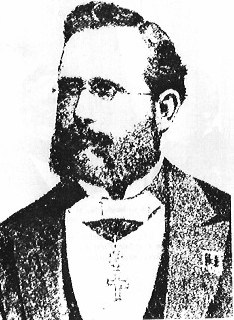
Kerckhoffs's Principle
An encryption scheme should be secure even if enemy knows everything about it except the key
Attacker knows all algorithms
Attacker does not know random numbers
Do not rely on secrecy of the algorithms (“security by obscurity”)
Jean-Guillaume-Hubert-Victor-François-Alexandre-Auguste Kerckhoffs von Nieuwenhof
Easy lesson:
use a good random number generator!

Slide 6
Symmetric encryption
Where do these
come from?
key generation
R = fresh
random bits
Kg
R_{k}
Handled
in TLS key
exchange
K
Optional
R_{m}
Enc
Dec
M or
error
C
C
M
C is a ciphertext
Correctness: Dec(K, Enc(K,R,M)) = M with probability 1 over randomness R used
Kerckhoffs’ principle: which parts are public and which are secret?

Slide 7
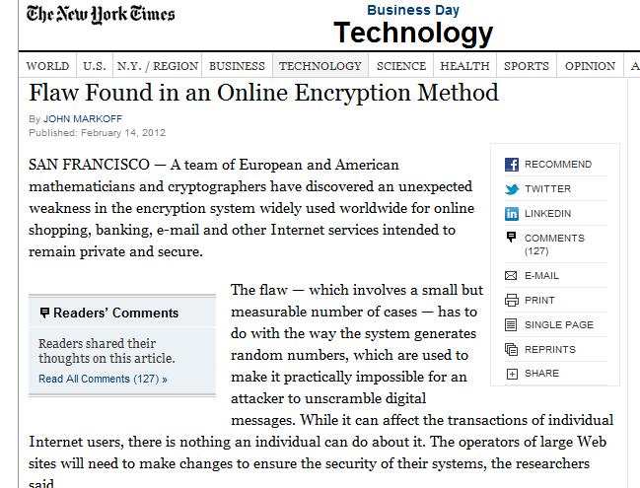
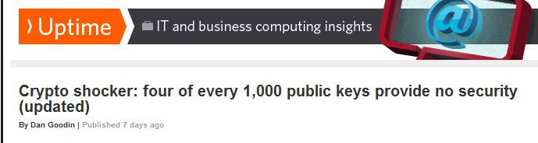
Randomness Matters!

Slide 8
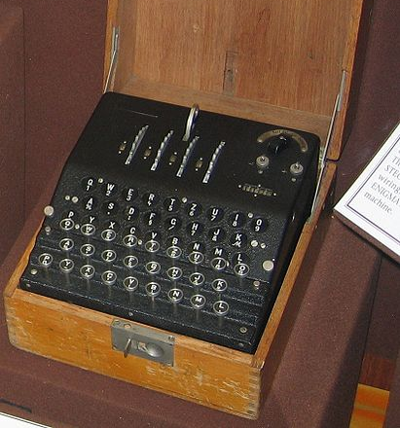
WW2 German Enigma machine
Polyalphabetic substitution cipher
Substitution table changes from character to character
Rotors control substitutions
Allies broke Enigma (even before the war), significant intelligence impact
Computers were built to break WW2 ciphers, by Alan Turing and others

Slide 9
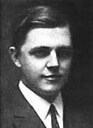
One-Time Pad (Vernam Cipher)
10111101…
-----
-----
-----
= 10111101…
⊕
⊕
10001111…
= 00110010…
00110010… =
Key is a random bit sequence
as long as the plaintext
Decrypt by bitwise XOR of
ciphertext and key:
ciphertext ⊕ key =
(plaintext ⊕ key) ⊕ key =
plaintext ⊕ (key ⊕ key) =
plaintext
Encrypt by bitwise XOR of
plaintext and key:
ciphertext = plaintext ⊕ key
Cipher achieves perfect secrecy if and only if there are as many possible keys as possible plaintexts, and every key is equally likely (Claude Shannon, 1949)

Slide 10
Advantages of One-Time Pad
Easy to compute
Encryption and decryption are the same operation
Bitwise XOR is very cheap to compute
As secure as theoretically possible
Given a ciphertext, all plaintexts are equally likely,
if and only if the key sequence is truly random
But how do the sender and the receiver communicate the key to each other? Where do they store the key?
regardless of attacker’s computational resources,
True randomness is expensive to obtain in large quantities
if and only if each key is as long as the plaintext

Slide 11
Problems with One-Time Pad
Key must be as long as the plaintext
Impractical in most realistic scenarios
Still used for diplomatic and intelligence traffic
Does not guarantee integrity
One-time pad only guarantees confidentiality
Attacker cannot recover plaintext, but can easily change it to something else
Insecure if keys are reused
Attacker can obtain XOR of plaintexts
No integrity

Slide 12
No Integrity
0
10111101…
-----
-----
-----
= 10111101…
⊕
0
⊕
10001111…
= 00110010…
00110010… =
Key is a random bit sequence
as long as the plaintext
Decrypt by bitwise XOR of
ciphertext and key:
ciphertext ⊕ key =
(plaintext ⊕ key) ⊕ key =
plaintext ⊕ (key ⊕ key) =
plaintext
Encrypt by bitwise XOR of
plaintext and key:
ciphertext = plaintext ⊕ key

Slide 13

Dangers of Key Reuse
P1=
00000000…
-----
-----
-----
= 0000000…
C1=
⊕
⊕
00110010…
= 00110010…
00110010… =
P2=
-----
-----
-----
= 1111111111…
C2=
⊕
11001101…
= 00110010…
Eavesdropper learns relationship between plaintexts
C1⊕C2 = (P1⊕K)⊕(P2⊕K) = (P1⊕P2)⊕(K⊕K) = P1⊕P2

Slide 14
Need Small, Reusable Keys
Use special cryptographic primitives: stream ciphers, block ciphers
Single key can be re-used (with some restrictions)
Not as theoretically secure as one-time pad

Slide 15
Stream Ciphers
One-time pad: Ciphertext(Key,Message)=Message⊕Key
Key must be a random bit sequence as long as the message
Idea: replace “random” with “pseudo-random”
Use a pseudo-random number generator (PRNG)
PRNG takes a short, truly random secret seed and expands it into a long “random-looking” sequence
E.g., 128-bit seed into a 10⁶-bit pseudo-random sequence
Ciphertext(Key,Msg)=IV, Msg⊕PRNG(IV,Key)
Message processed bit by bit (unlike block cipher)
No efficient algorithm can tell
this sequence from truly random

Slide 16
Stream Cipher Terminology
The seed of a pseudo-random generator typically consists of initialization vector (IV) and key
The key is a secret known only to the sender and the recipient, not sent with the ciphertext
IV is usually sent with the ciphertext
The pseudo-random bit stream produced by PRNG(IV,key) is referred to as the keystream
Encrypt message by XORing with keystream:
ciphertext = message ⊕ keystream

Slide 17

Properties of Stream Ciphers
Usually very fast (faster than block ciphers)
Used where speed is important: WiFi, DVD, RFID, VoIP
Unlike one-time pad, stream ciphers do not provide perfect secrecy
Only as secure as the underlying PRNG
If used properly, can be as secure as block ciphers
PRNG must be cryptographically secure

Slide 18
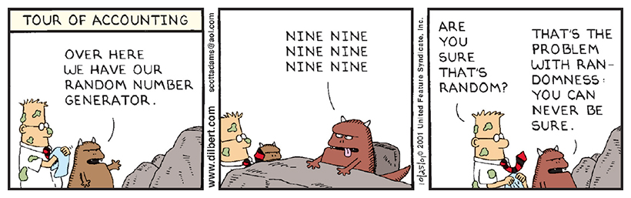
How Random is “Random”?

Slide 19
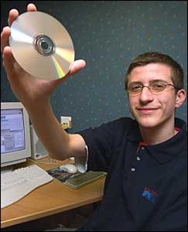
Cryptographically Secure PRNG
Common PRNGs are not cryptographically secure
Example: LFSR generator in DVD Content Scrambling System, broken in the early 2000s
RC4
Popular stream cipher from Ron Rivest, many weaknesses, not recommended anymore
Many modern alternatives
For example, CTR modes of block ciphers such as AES
Jon Lech Johansen (“DVD Jon”)

Slide 20
Using Stream Ciphers
No integrity
Associativity & commutativity:
(M₁⊕PRNG(seed)) ⊕ M₂ = (M₁⊕M₂) ⊕ PRNG(seed)
Need an additional integrity protection mechanism
Known-plaintext attack is very dangerous if keystream is ever repeated
Self-cancellation property of XOR: X⊕X=0
(M₁⊕PRNG(seed)) ⊕ (M₂⊕PRNG(seed)) = M₁⊕M₂
If attacker knows M₁, then easily recovers M₂ … also, most plaintexts contain enough redundancy that can recover parts of both messages from M₁⊕M₂

Slide 21
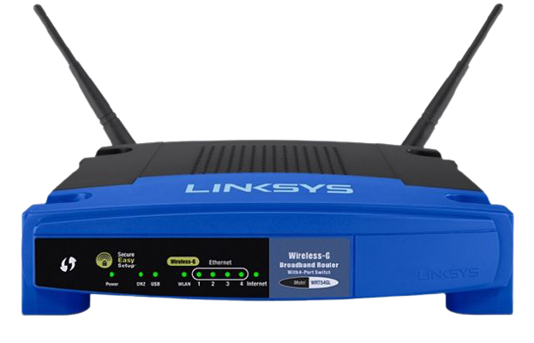
Case Study: WEP (Wired Equivalent Privacy)
Original Wi-Fi encryption in the 802.11b standard
Goals: confidentiality, integrity, authentication
Intended to make wireless as secure as wired network
Assumes that a secret key is shared between access point and client
Uses RC4 stream cipher seeded with 24-bit initialization vector and 40-bit key
Terrible design choice for wireless environment

Slide 22
Shared Key Authentication
Prior to communicating data, access point may require client to authenticate
Access Point
Client
beacon
unauthenticated &
unassociated
OR
probe request
challenge
authenticated &
unassociated
IV, challenge⊕RC4(IV,K)
association request
authenticated &
associated
association response
Passive eavesdropper recovers RC4(IV,K),
can respond to any subsequent challenge
without knowing K

Slide 23
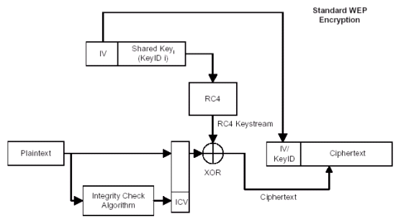
How WEP Works
(IV, shared key) used as RC4 seed
Must never be repeated (why?)
There is no key update protocol, so security relies on never repeating IV
24 bits
40 bits
no integrity!
IV sent in the clear
Worse: changing IV with each packet is optional!
CRC-32 checksum is linear in ⊕:
if attacker flips some plaintext bits, he knows which
bits of CRC to flip to produce the same checksum

Slide 24
RC4 Was a Bad Choice for Wireless
Stream ciphers require sender and receiver to be at the same place in the keystream
Not suitable when packet losses are common
WEP solution: a separate keystream for each packet (requires a separate seed for each packet)
Can decrypt a packet even if a previous packet was lost
But there aren’t enough possible seeds!
RC4 seed = 24-bit initialization vector + fixed key
Assuming 1500-byte packets at 11 Mbps,
2²⁴ possible IVs will be exhausted in about 5 hours
Seed reuse is deadly for stream ciphers

Slide 25
Recovering the Keystream
Plaintexts are not random (for example, IP packet structure is very regular).
Even without knowing the plaintext, can exploit plaintext regularities to recover partial keystream.
Recover keystream:
C ⊕ M = (M⊕RC4(IV,key)) ⊕ M = RC4(IV,key)
Not a problem if the keystream is never re-used!
Get access point to encrypt a known plaintext M
Send spam, AP will encrypt and forward
Get victim to send an email with known content

Slide 26



Keystream Will Be Re-Used
In WEP, repeated IV = repeated keystream
Busy network will repeat IVs often
Many cards reset IV to 0 when re-booted, then increment by 1 ⇒ expect re-use of low-value IVs
If IVs are chosen randomly, expect repetition in O(2¹²) due to birthday paradox
Recover keystream for each IV, store in table:
(KnownM ⊕ RC4(IV,key)) ⊕ KnownM = RC4(IV,key)
Wait for IV to repeat, decrypt, enjoy plaintext:
(M’ ⊕ RC4(IV,key)) ⊕ RC4(IV,key) = M’

Slide 27
It Gets Worse
Misuse of RC4 in WEP is a design flaw with no fix
Longer keys do not help! The problem is re-use of IVs, their size is fixed (24 bits)
Attacks are passive and very difficult to detect
Perfect target for the Fluhrer et al. attack on RC4
Attack requires known IVs of a special form
WEP sends IVs in plaintext
Generating IVs as counters or random numbers will produce enough “special” IVs in a matter of hours
This results in key recovery (not just keystream)
Can decrypt even ciphertexts whose IV is unique

Slide 28
Fix in 802.11i
Patch (TKIP): still RC4, but encrypts IVs and establishes new shared keys for every 10 KBytes transmitted
Use same network card, only upgrade firmware
Deprecated by the Wi-Fi alliance
Long-term: AES in CCMP mode, 128-bit keys, 48-bit IVs
Block cipher in a stream cipher-like mode

Slide 29

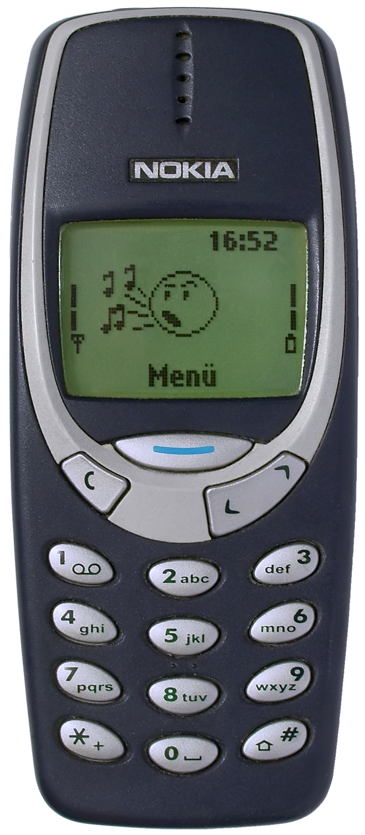
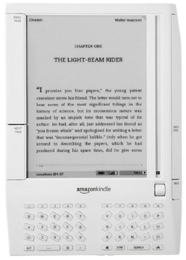
Many Stream Cipher Attacks Over the Years
MIFARE cards
A5/1 GSM cipher
Kindle DRM

Slide 30
Block Ciphers
Operates on a single chunk (“block”) of plaintext
For example, 64 bits for DES, 128 bits for AES
Same key is reused for each block (can use short keys)
Result should look like a random permutation
Not impossible to break, just very expensive
If there is no more efficient algorithm (unproven assumption!), can only break the cipher by brute-force, try-every-possible-key search
Time and cost of breaking the cipher exceed the value and/or useful lifetime of protected information

Slide 31
A Bit of Block Cipher History
Playfair and variants (from 1854 until WW2)
Feistel structure
“Ladder” structure: split input in half, put one half through the round and XOR with the other half… after 3 random rounds, ciphertext indistinguishable from a random permutation
DES: Data Encryption Standard
Invented by IBM, issued as federal standard in 1977
64-bit blocks, 56-bit key + 8 bits for parity
Very widely used (usually as 3DES) until recently
3DES: DES + inverse DES + DES (with 2 or 3 different keys)

Slide 32
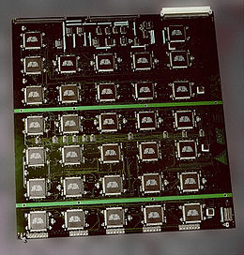
Best Attacks Against DES
Attack | Attack type | Complexity | Year
Biham, Shamir | Chosen plaintexts, recovers key | 2⁴⁷ plaintext, ciphertext pairs | 1992
Matsui | Known plaintext, ciphertext pairs, recovers key | 2⁴² plaintext, ciphertext pairs, ~2⁴¹ DES computations | 1993
DESCHALL | Unknown plaintext, recovers key | 2^{56/4} DES computations 41 days | 1997
EFF Deep Crack | Unknown plaintext, recovers key | ~4.5 days | 1998
Deep Crack + DESCHALL | Unknown plaintext, recovers key | 22 hours | 1999
EFF’s custom machine with “Deep Crack” chips

Slide 33

Advanced Encryption Standard (AES)
US federal standard as of 2001
Based on the Rijndael algorithm
128-bit blocks, keys can be 128, 192 or 256 bits
Design uses some clever math
Take a cryptography course to learn more!

Slide 34
Encrypting a Large Message
So, we’ve got a good block cipher, but our message is longer than 128 bits…

Slide 35
Electronic Code Book (ECB) Mode
plaintext
key
key
key
key
key
block
cipher
block
cipher
block
cipher
block
cipher
block
cipher
ciphertext
Identical blocks of plaintext produce identical blocks of ciphertext
No integrity checks: can mix and match blocks

Slide 36


ECB Mode Leaks Information!
Encrypt in ECB mode

Slide 37
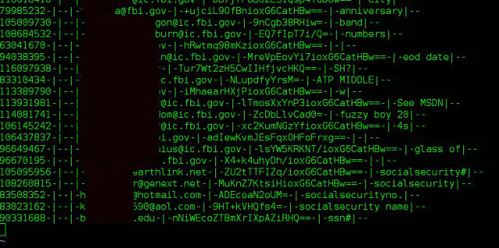
Remember Adobe Passwords Leak?
153 million account passwords leaked in 2013
Encrypted using 3DES in ECB mode rather than hashed

Slide 38
Cipherblock Chaining (CBC) Mode: Encryption
plaintext
Initialization
vector
⊕
⊕
⊕
⊕
key
key
key
key
block
cipher
block
cipher
block
cipher
block
cipher
Sent with ciphertext
(preferably encrypted)
ciphertext
Identical blocks of plaintext encrypted differently
Last cipherblock depends on entire plaintext
Still does not guarantee integrity…

Slide 39
CBC Mode: Decryption
plaintext
Initialization
vector
⊕
⊕
⊕
⊕
key
key
key
key
decrypt
decrypt
decrypt
decrypt
ciphertext

Slide 40
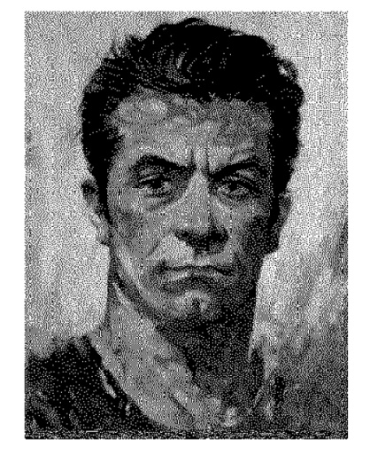
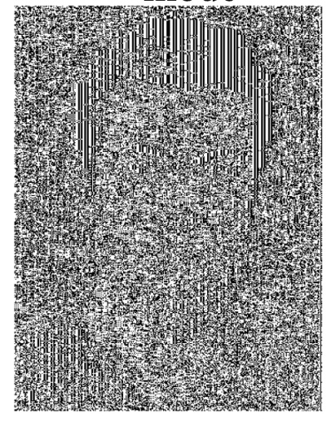

ECB vs. CBC
Picture credit: Bart Preneel
AES in ECB mode
AES in CBC mode
Similar plaintext
blocks produce
similar ciphertext
blocks (not good!)

Slide 41
Choosing the Initialization Vector
Key used only once
No IV needed (can use IV=0)
Key used multiple times
Best: fresh, random IV for every message
Can use unique IV (eg, counter), but then the first step in CBC mode must be IV’ ← E(k, IV)
Example: Windows BitLocker
May not need to transmit IV with the ciphertext
Key used multiple times,
unique messages
Synthetic IV: IV ← F(k’, message)
F is a cryptographically secure keyed pseudorandom function

Slide 42
CBC and Electronic Voting
Kohno, Stubblefield, Rubin, Wallach
plaintext
Initialization
vector
(supposed to
be random)
⊕
⊕
⊕
⊕
key
key
key
key
DES
DES
DES
DES
ciphertext
Found in the source code for Diebold voting machines:
DesCBCEncrypt((des_c_block*)tmp, (des_c_block*)record.m_Data,
totalSize, DESKEY, NULL, DES_ENCRYPT)

Slide 43
CTR (Counter Mode)
Still does not guarantee integrity
Fragile if counter repeats
plaintext
Random IV
key
key
key
key
⊕
⊕
⊕
⊕
Enc(IV)
Enc(IV+1)
Enc(IV+2)
Enc(IV+3)
IV
ciphertext

Slide 44
Checking If Message Decrypted Correctly
M1
M2||P
Assume that
M1||M2 has length 2n-8 bits
IV
E_{K}
E_{K}
P is one byte of padding
that must equal 0x00
C0
C1
C2
Dec(K,C’ )
M1’||M2’||P’ = CBC-Dec(K,C’)
If P’ ≠ 0x00 then
Return error
Else
Return ok
C0, C1, C2
ok
Adversary obtains
ciphertext C0,C1,C2
C0, C1 1, C2
error

Slide 45
Padding Oracle Attack
M1
M2||P
Assume that
M1||M2 has length 2n-8 bits
IV
E_{K}
E_{K}
P is one byte of padding
that must equal 0x00
C0
C1
C2
R, C0, C1
Dec(K,C’ )
M1’||M2’||P’ = CBC-Dec(K,C’)
If P’ ≠ 0x00 then
Return error
Else
Return ok
error
R, C0 1, C1
Adversary obtains
ciphertext C0,C1,C2
Let R be arbitrary bits
error
…
R, C0 i C1
ok!

Slide 46
High-Level Intuition
Learning last byte of this sum = learning last byte of unknown plaintext
….
X
= Unknown plaintext ⊕ known value
E_{K}
E_{K}
Decryption succeeded, therefore last byte = known padding value
Known to attacker
C0 i
C1
R, C0 i C1
Dec(K,C’ )
M1’||M2’||P’ = CBC-Dec(K,C’)
If P’ ≠ 0x00 then
Return error
Else
Return ok
ok!

Slide 47

Adversary’s Analysis
M1 C0 C0 i = M1 i
Last byte of this value must be 00 (why?)
M1
M2||00
….
X
IV
….
M1 C0
Therefore, last byte of M1 is i
E_{K}
E_{K}
E_{K}
E_{K}
R
C0 i
C1
E_{K} (M1 C0)
C0
C1
C2
R, C0 i C1
Dec(K,C’ )
M1’||M2’||P’ = CBC-Dec(K,C’)
If P’ ≠ 0x00 then
Return error
Else
Return ok
ok!
Adversary obtains
ciphertext C0,C1,C2
Let R be arbitrary bits

Slide 48
Padding for CBC Mode in TLS
Message
Padding
00
Random IV
E_{K}
E_{K}
C₀
C₁
C₂
Possible paddings in TLS: 00, 01 01, 02 02 02, etc.

Slide 49
Padding for CBC Mode in TLS
Message
Padding
11
11
11
…
11
Random IV
E_{K}
E_{K}
E_{K}
C₀
C₁
C₂
C₃
Possible paddings in TLS: 00, 01 01, 02 02 02, etc.
“Lengths longer than necessary might be desirable to frustrate attacks on a protocol that are based on analysis of the lengths of exchanged messages.”
RFC 5246
These are called “traffic analysis” attacks

Slide 50
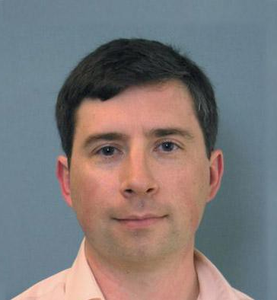
Vaudenay’s Padding Oracle Attack
M1
M2||P
IV
Goal:
decrypt entire plaintext
E_{K}
E_{K}
C0
C1
C2
We know that:
00 = i ⊕ IV[n] ⊕ M1[n]
00…00, C1
Dec(K,C’ )
M1’ = CBC-Dec(K,C’)
(X,plen) <- lastbyte(M1’)
For i = 0 to padlen do
(X,plen’) <- lastbyte(X)
If plen’ != plen return Error
Return Ok
error
Or do we? Could be:
01 = i ⊕ IV[n] ⊕ M1[n]
01 = IV[n-1] ⊕ M1[n-1]
00...01, C1
error
…
00… i, C1
Easy to exclude other cases
ok

Slide 51
Vaudenay’s Padding Oracle Attack
M1
M1’
IV+M1
IV
Attack second-to-last byte
E_{K}
E_{K}
C0
C1
00… i j
C1
Pick j to ensure last padding byte is correct
We know M1[n]. Let’s get second to last byte.
00…00 j, C1
Dec(K,C’ )
M1’ = CBC-Dec(K,C’)
(X,plen) <- lastbyte(M1’)
For i = 0 to padlen do
(X,plen’) <- lastbyte(X)
If plen’ != plen return Error
Return Ok
error
Solve j to make M1’[n] = 01
01 = j ⊕ IV[n] ⊕ M1[n]
00...01 j, C1
error
…
Know that:
01 = i ⊕ IV[n-1] ⊕ M1[n-1]
00… i j, C1
ok
Repeat for all n bytes

Slide 52
Chosen-Ciphertext Attacks on CBS
Means what?
Attack | Description | Year
Vaudenay | 10’s of chosen ciphertexts, recovers message bits from a ciphertext. Called “padding oracle attack” | 2001
Canvel et al. | Shows how to use Vaudenay’s ideas against TLS | 2003
Degabriele, Paterson | Breaks IPsec encryption-only mode | 2006
Albrecht et al. | Plaintext recovery against SSH | 2009
Duong, Rizzo | Breaks ASP.net encryption | 2011
Jager, Somorovsky | XML encryption standard | 2011
Duong, Rizzo | “Beast” attacks against TLS | 2011

Slide 53
When Is an Encryption Scheme “Secure”?
Hard to recover plaintext from ciphertext?
What if attacker learns only some bits of the plaintext? Some function of the bits? Some partial information about the plaintext?
Fixed mapping from plaintexts to ciphertexts?
What if attacker sees two identical ciphertexts and infers that the corresponding plaintexts are identical?
What if attacker guesses the plaintext – can he verify his guess?
Implication: encryption must be randomized or stateful

Slide 54
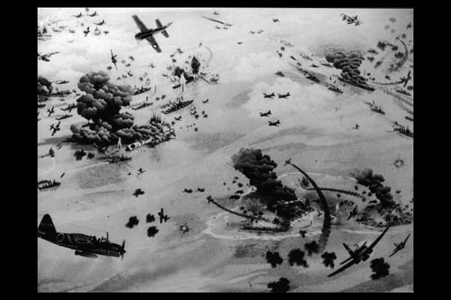

How Can a System Be Attacked?
Attackers knows the ciphertext and the encryption algorithm
What else does the attacker know? Depends on the application!
Known-plaintext attack (stronger)
Attacker knows some plaintext-ciphertext pairs
Chosen-plaintext attack (even stronger)
Attacker can obtain ciphertext for any plaintext of his choice
Chosen-ciphertext attack (very strong)
Attacker can decrypt any ciphertext except the target
Sometimes very realistic

Slide 55
Known-Plaintext Attack
Extracting password from an encrypted PKZIP file …
“… I opened the ZIP file and found a `logo.tif’ file, so I went to their main Web site and looked at all the files named `logo.tif.’ I downloaded them and zipped them all up and found one that matched the same checksum as the one in the protected ZIP file”
With known plaintext, PkCrack took 5 minutes to extract the key
Biham-Kocher attack on PKZIP stream cipher
From Kevin Mitnick’s “The Art of Intrusion”

Slide 56
Very Informal Intuition
Minimum security
requirement for any
modern encryption scheme
Security against chosen-plaintext attack
Ciphertext leaks no information about the plaintext
Even if the attacker correctly guesses the plaintext, he cannot verify his guess
Every ciphertext is unique, encrypting same message twice produces completely different ciphertexts
Security against chosen-ciphertext attack
Integrity protection – it is not possible to change the plaintext by modifying the ciphertext
Simple exercise: show that ECB mode is not secure

Slide 57
The Chosen-Plaintext Game
Attacker does not know the key
He chooses as many plaintexts as he wants, and receives the corresponding ciphertexts
When ready, he picks two plaintexts M₀ and M₁
He is even allowed to pick plaintexts for which he previously learned ciphertexts!
He receives either a ciphertext of M₀, or a ciphertext of M₁
He wins if he guesses correctly which one it is

Slide 58
Meaning of “Leaks No Information”
Idea: given a ciphertext, attacker should not be able to learn even a single bit of useful information about the plaintext
Let Enc(M₀,M₁,b) be a “magic box” that returns encrypted M_{b}
Given two plaintexts, the box always returns the ciphertext of the left plaintext or right plaintext
Attacker can use this box to obtain the ciphertext of any plaintext M by submitting M₀=M₁=M, or he can try to learn even more by submitting M₀≠M₁
Attacker’s goal is to learn just this one bit b
0 or 1

Slide 59
Chosen-Plaintext Security
Consider two experiments (A is the attacker)
Experiment 0 Experiment 1
A interacts with Enc(-,-,0) A interacts with Enc(-,-,1)
and outputs his guess of bit b and outputs his guess of bit b
Identical except for the value of the secret bit
b is attacker’s guess of the secret bit
Attacker’s advantage is defined as
| Prob(A outputs 1 in Exp0) - Prob(A outputs 1 in Exp1)) |
Encryption scheme is chosen-plaintext secure if this advantage is negligible for any efficient A

Slide 60
A Simple Example
Any deterministic, stateless symmetric encryption scheme is insecure
Attacker can easily distinguish encryptions of different plaintexts from encryptions of identical plaintexts
This includes ECB mode of common block ciphers!
Attacker A interacts with Enc(-,-,b)
Let X,Y be any two different plaintexts
C₁ ← Enc(X,X,b); C₂ ← Enc(X,Y,b);
If C₁=C₂ then b=0 else b=1
The advantage of this attacker A is 1
Prob(A outputs 1 if b=0)=0 Prob(A outputs 1 if b=1)=1

Slide 61
Authenticated Encryption
Goal: Hide message (confidentiality) and detect tampering (integrity)
Can build by combining encryption with message authentication scheme
https://amazon.com
K
K
Something’s fishy… I’ll discard this.
Enc(K, “Quantity: 100 ,
CC#: 5415431230123456”)
10000000

Slide 62
Message Authentication
key generation
Optional. If no randomness, then called Message Authentication Code (MAC)
Kg
R_{k}
K
R
Tag
Msg
Ver
T
0 or 1
Msg
T

Slide 63
Message Authentication
Msg, T
K
K
Sender
Receiver
Two algorithms:
Tag(K,Msg) outputs a tag T
Verify(K,Msg,T) outputs 0/1 (invalid / valid)
Security: No computationally efficient attacker can forge tags for a new message even when attacker gets
(Msg₁ , T₁) , (Msg₂, T₂), … , (Msg_{q} , T_{q})
for messages of his choosing and reasonably large q

Slide 64
CBC-MAC
Split message into blocks M1, M2, M3
M1
M2
M3
E_{K}
E_{K}
E_{K}
T
This is a secure MAC
if K used only on same-length messages

Slide 65
Variable-Length CBC-MAC
|M|
M1
M2
E_{K}
E_{K}
E_{K}
Prepend message length
T
or
M1
M2
M3
Encrypted CBC-MAC
E_{K}
E_{K}
E_{K}
E_{K’}
T

Slide 66
Message Authentication with HMAC
Kgen outputs uniform bit string K
Tag(K,M) = HMAC(K,M) defined by:
ipad != opad are constants
K ipad || M
H
K opad || h
H
T
To verify a M,T pair, check if HMAC(K,M) = T
Unforgeability holds if hash function H behaves like a random function

Slide 67
Encrypt + MAC
Goal: confidentiality + integrity + authentication
Can tell if messages
are the same!
Breaks chosen-plaintext security
K1, K2
MAC=HMAC(K2,msg)
K1, K2
msg
Decrypt
encrypt(msg), MAC(msg)
encrypt(msg2), MAC(msg2)
?
Alice
=
Bob
Encrypt(K1,msg)
Verify MAC
MAC is deterministic: messages are equal ⇒ their MACs are equal
Solution: Encrypt, then MAC (or MAC, then encrypt)

Slide 68
Authenticated Encryption Schemes
Attack | Inventor(s) | Notes
OCB (Offset Codebook) | Rogaway | One-pass mode and fastest
AES-GCM (Galois Counter Mode) | McGrew, Viega | CTR mode plus Carter-Wegman MAC
ChaCha20/Poly1305 | Bernstein | “essentially” CTR mode plus special Carter-Wegman MAC
CCM | Housley, Ferguson, Whiting | CTR mode plus CBC-MAC
EAX | Wagner, Bellare, Rogaway | CTR mode plus OMAC
Other considerations in authenticated encryption (AE):
robustness & IV misuse, deterministic AE, associated data, …

